Slide 1


Slide 2

3 AMIGOS
Case Study about

Slide 3
ABOUT
Zomato is an Indian restaurant aggregator and food delivery application
Was founded by Deepinder Goyal and Pankaj Chaddah in 2008
Zomato was initially named as Foodiebay
As of 2019, the service is available in 24 countries and in more than 10,000 cities

Slide 4
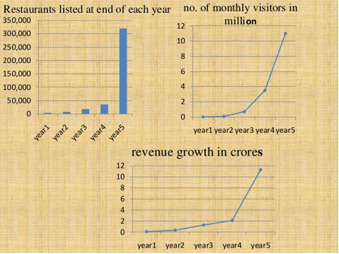
ZOMATO STATISTICS

Slide 5
WHAT ZOMATO DOES
It empowers individuals to get food from local eateries and restaurants delivered at their doorstep for a small fee
The platform also provides information about close-by restaurants, their menu cards, average cost, ratings and reviews
Zomato delivers food with the assistance of their human network

Slide 6
TO ORDER FOOD
URL
www.zomato.com

Slide 7
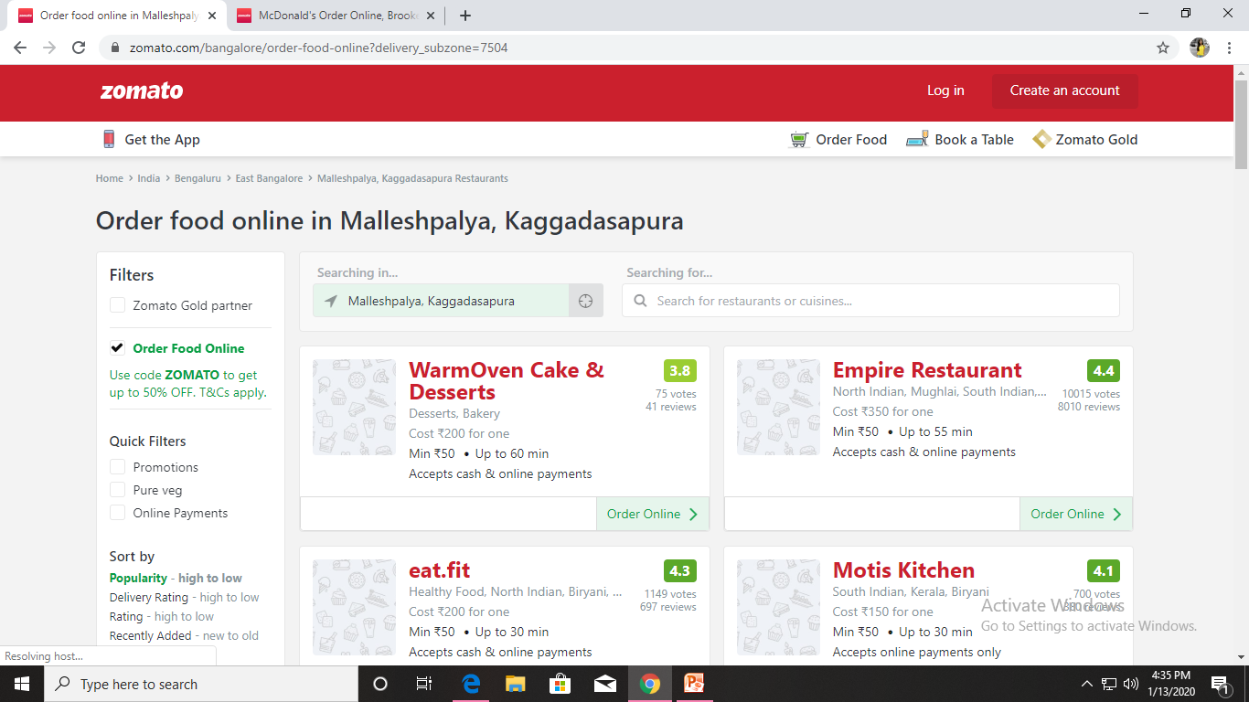
HOME PAGE

Slide 8
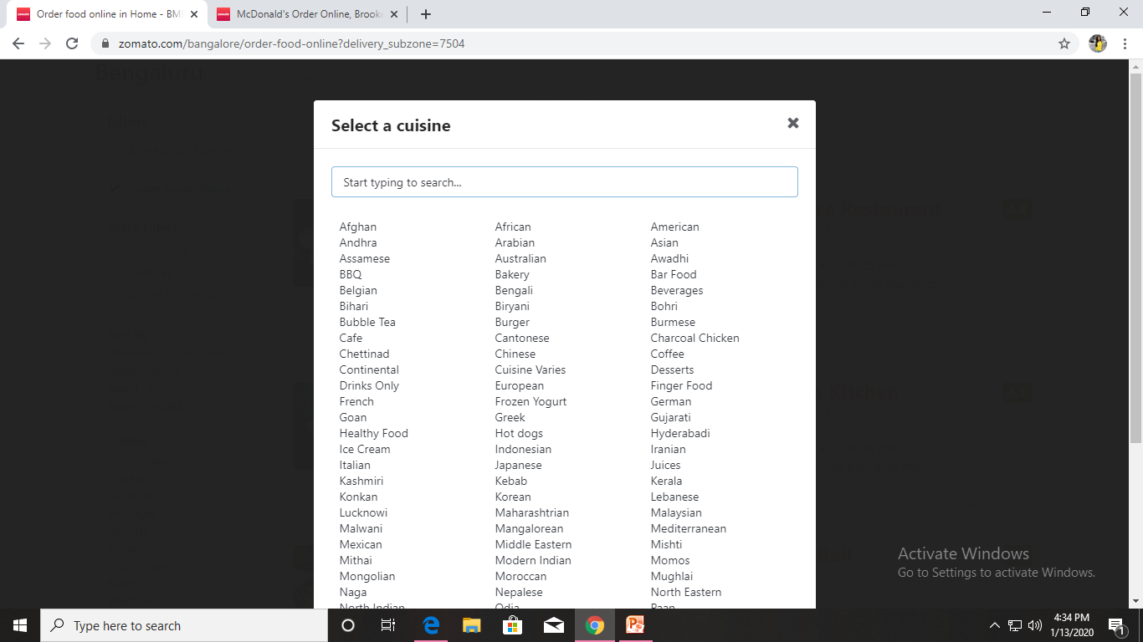
CUISINE PAGE

Slide 9
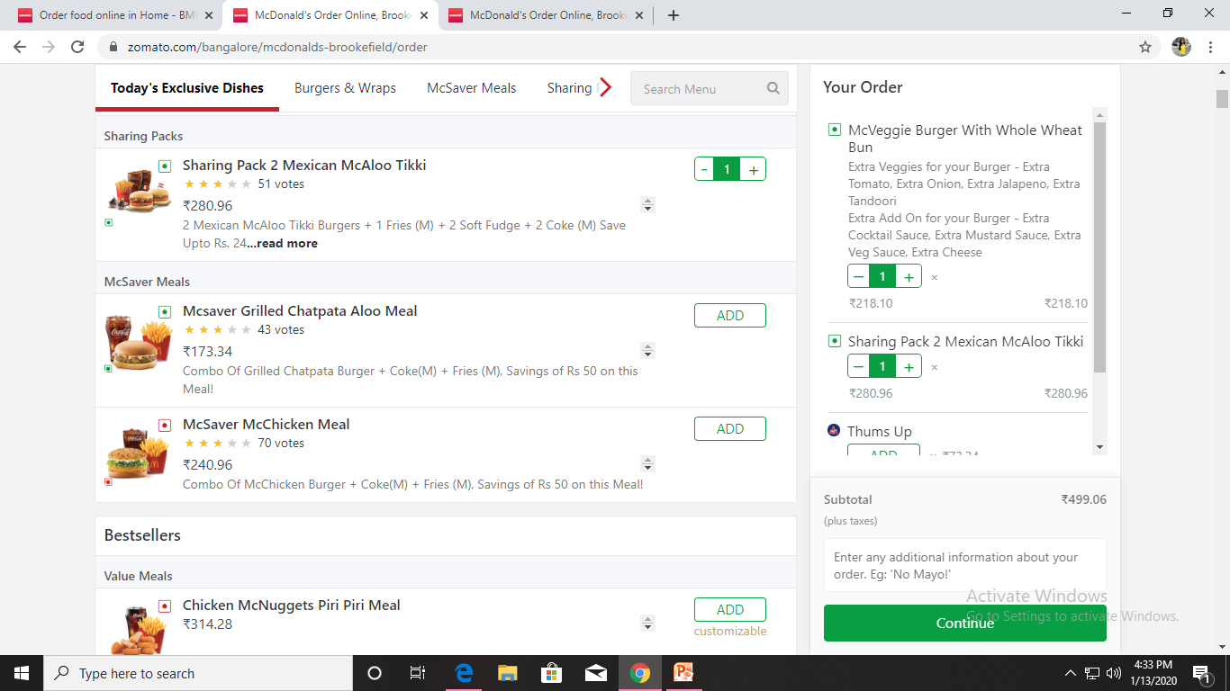
SAMPLE RESTAURANT PAGE

Slide 10
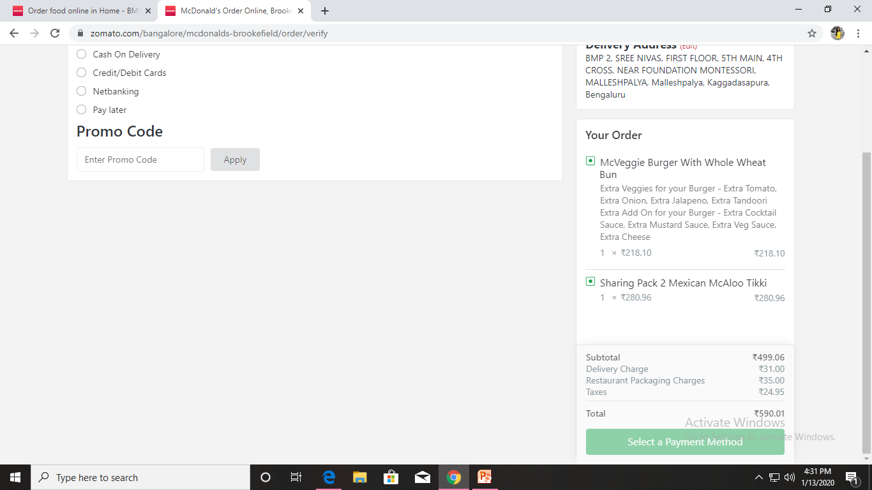
CART PAGE/PAYMENT PAGE

Slide 11
